Slide 1
SADC negotiations on trade in communication services
Workshop for 22nd TNF Services
Johannesburg
4 August 2014

Slide 2
Outline
State of play in negotiations
Classification issues
Summary of requests and offers
Issues related to TCM Protocol
Issues arising from sector study
How will the negotiations make a difference to regional trade
Decisions required
Key questions for breakout groups

Slide 3
State of play in negotiations
Certain level of experience in negotiations
SADC
Policy & regulatory harmonization and cooperation negotiated in 1998
one of the six priority sectors – 5 requests (1 recent) and 9 (2 recent) offers so far
No substantive TiS negotiations as yet but bilateral
Trade liberalization at WTO during Uruguay round 1994
Six SADC MS have GATS commitments
Reference paper on basic telecommunication
Classifications & definitions and disciplines on domestic regulations
Trade liberalization at COMESA
Six SADC MS involved (5 offers so far)

Slide 4


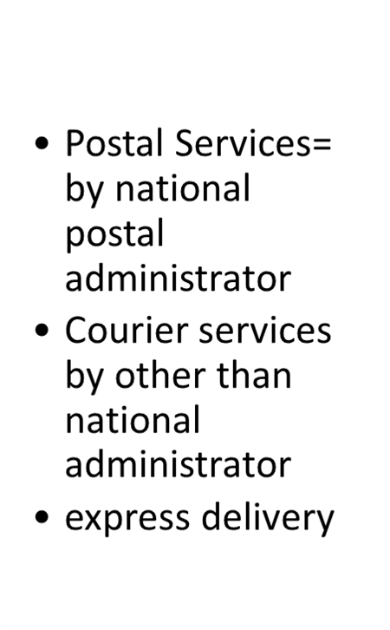


Classification
Basic telecommunication
Value added
Unified/converged services
“Use” Vs “supply”
Broadcasting services (radio & TV)
Motion picture and video tape projection and distribution
Motion picture and video projection
Sound recording
picture and video tape projection and distribution
Motion picture and video projection
Sound recording
Telecommunication services
Audio-visual services
Postal & Courier services

Slide 5
Table 3.1: SADC country profiles and regional dashboard

Slide 6
Summary of requests and offers
Requests
Offers
Post & courier
2 postal and 5-courier services requests but all MS (indicate reserved services)
Telecoms
5 requests but to all MS
Audio-visual
3 requests and to all but 1 MS
Postal & Courier service
4 offers in Postal (2 combine P &C) _{+exp. delry} excluding reserved services
Telecoms
8 offers but 1covers a few basic telecoms (4 incl.TRP)
M2: termination of int. calls & callback
M3 limitations: foreign share capital, ENT (# of licenses), constr. of own infra.
Audio-visual
4 offers (2 only b.casting, 1 in subsectors (a-d) and 1in subsector (b) only)
M3: % of foreign ownership & broadcast % national progr. (NT)

Slide 7
Overview of Requests

Slide 8
Overview of Offers

Slide 9
Regulatory issues: Postal & Courier
Chapter 11 of TCM provisions:
separation of the regulatory responsibilities from postal operators
universal service
network interoperability
postal security
human resource training and development and
the inclusion of the postal sector in national ICT policies
Effective and transparent regulations
Business practices
Proposal under GATS: reference paper on Postal & Courier Services
TiS Protocol

Slide 10
Regulatory Issues: Telecommunication & broadcasting
Chapter 10 of TCM: ICT (Telecoms and broadcasting)
Competitive safeguards
Interconnection
Universal services
Licensing
Independence of regulators
Allocation of scarce resource
No similar regulatory disciplines for audio-visual services in the GATS other than the DR and other non-broadcasting in the context of SADC
Similar provisions in the TRP proposed for adoption in SADC TiS by 4 MS

Slide 11
Issues from Sector study
Postal & Courier Services
All MS have postal monopoly services = a positive list of “reserve services”
Most MS have liberalized courier services
Access of Universal services fund and the obligation to provide such services
Independent regulator
Telecommunications
Most MS use converged services classification for licensing “network, services & infrastructure”
Most MS are TRP compliant except for a few areas
Liberal regimes Vs GATS commitments
Liberalization levels Vs access to ICT services
Fairly competitive
Audio-visual services
Most MS regulates broadcasting services - liberal regimes except “cross-media ownership & foreign shareholders” other not regulations for audio-visual
multi-tier licensing regimes – “community Vs national”, “public Vs commercial” and “private”

Slide 12
How will the negotiations make difference in regional trade?
SADC objective in ICT Sector is … ensure access to adequate high quality and efficient services (ICT) … for socio-economic development in the region
Provide legal certainty on trade regulations in the sector
Attract (regional) investment =more players
Competition- efficiency and effective
Learn from each other : policy and regulatory cooperation, share scarce resources, interconnections, human resource development, etc.
….. Etc.
ICT as infrastructure for trade in Goods and other services sector

Slide 13
Issues for Decisions
How should TNF address classification issues?
Postal Vs Courier Services (the distinction and incl. of exp. delivery services)
What is the best approach on regulatory issues?
How should MS reflect existing undertakings under TCM & TiS Protocols?
Proposed reference paper on “postal and courier services”
TRP: SADC wide adoption Vs additional commitment
To what extent do the offers respond to requests so far made in communication services? Do offers meet the requirement of “better than GATS commitments?

Slide 14
Issues for group discussions
Consider and recommend one option on each of the issues identified in the “Background Note” in particular:
Classification of Postal & courier services
How can the regulatory undertaking in TCM protocol be reinforced by commitments under the TiS Protocol?
Treatment of regulatory issues and the proposal for reference paper on postal and courier services
Regulatory disciplines in telecommunication services “TRP”

Slide 15
Thank You by: vsawere@sadc.int

